Slide 1
LLMs in Action: Developing a COM AI Player for an Interactive Tic-Tac-Toe Game using OpenAI Developer API
Lesson 2: REST APIs & OpenAI Developer APIs
Priscilla Emasoga
COM3550 Undergraduate Ambassadors Scheme
University of Sheffield

Slide 2
Overview
What is an API?
Web APIs
REST APIs
REST API Principles
OpenAI Developer APIs
Chat Completions API
COM3550, Undergraduate Ambassadors Scheme
1/17

Slide 3
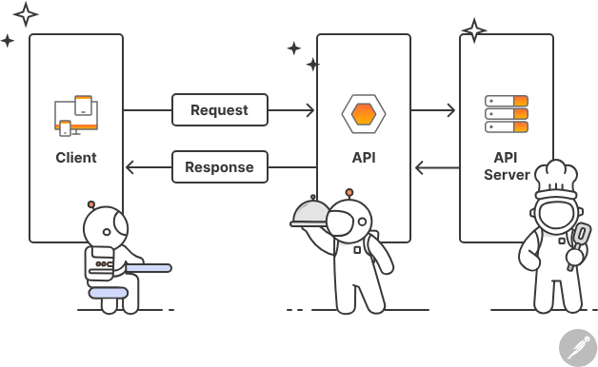
What is an API?
An API (Application Programming Interface) is a set of protocols that enable different software applications to communicate with each other.
Acts as an intermediary between different systems or components of a system.
Facilitates the exchange of data between them.
Example: A restaurant: The customer (user) orders food through a waiter (API), who communicates with the kitchen (server) and returns the food (response) to the customer.
Image from www.postman.com
COM3550, Undergraduate Ambassadors Scheme
1/14

Slide 4
Web APIs
A Web API is an API that can be accessed using the HTTP protocol.
Not all APIs are web APIs.
Some APIs are used only for communication between two applications on the same computer and do not require a web connection.
Web APIs can be categorized based on their architecture
REST APIs – Use standard HTTP methods, stateless, widely used.
SOAP APIs – XML-based, strict structure, used in enterprise applications.
GraphQL APIs – Flexible queries, fetch specific data efficiently.
gRPC APIs – High-performance, uses Protocol Buffers.
We will focus on REST APIs
COM3550, Undergraduate Ambassadors Scheme
1/14

Slide 5
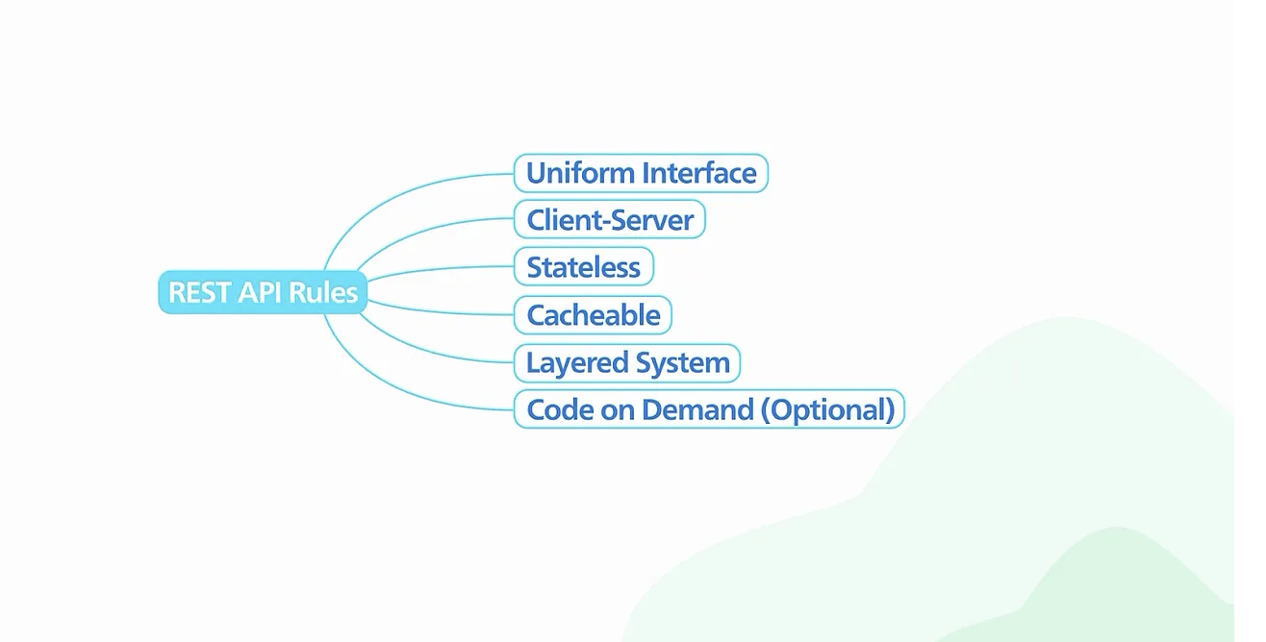
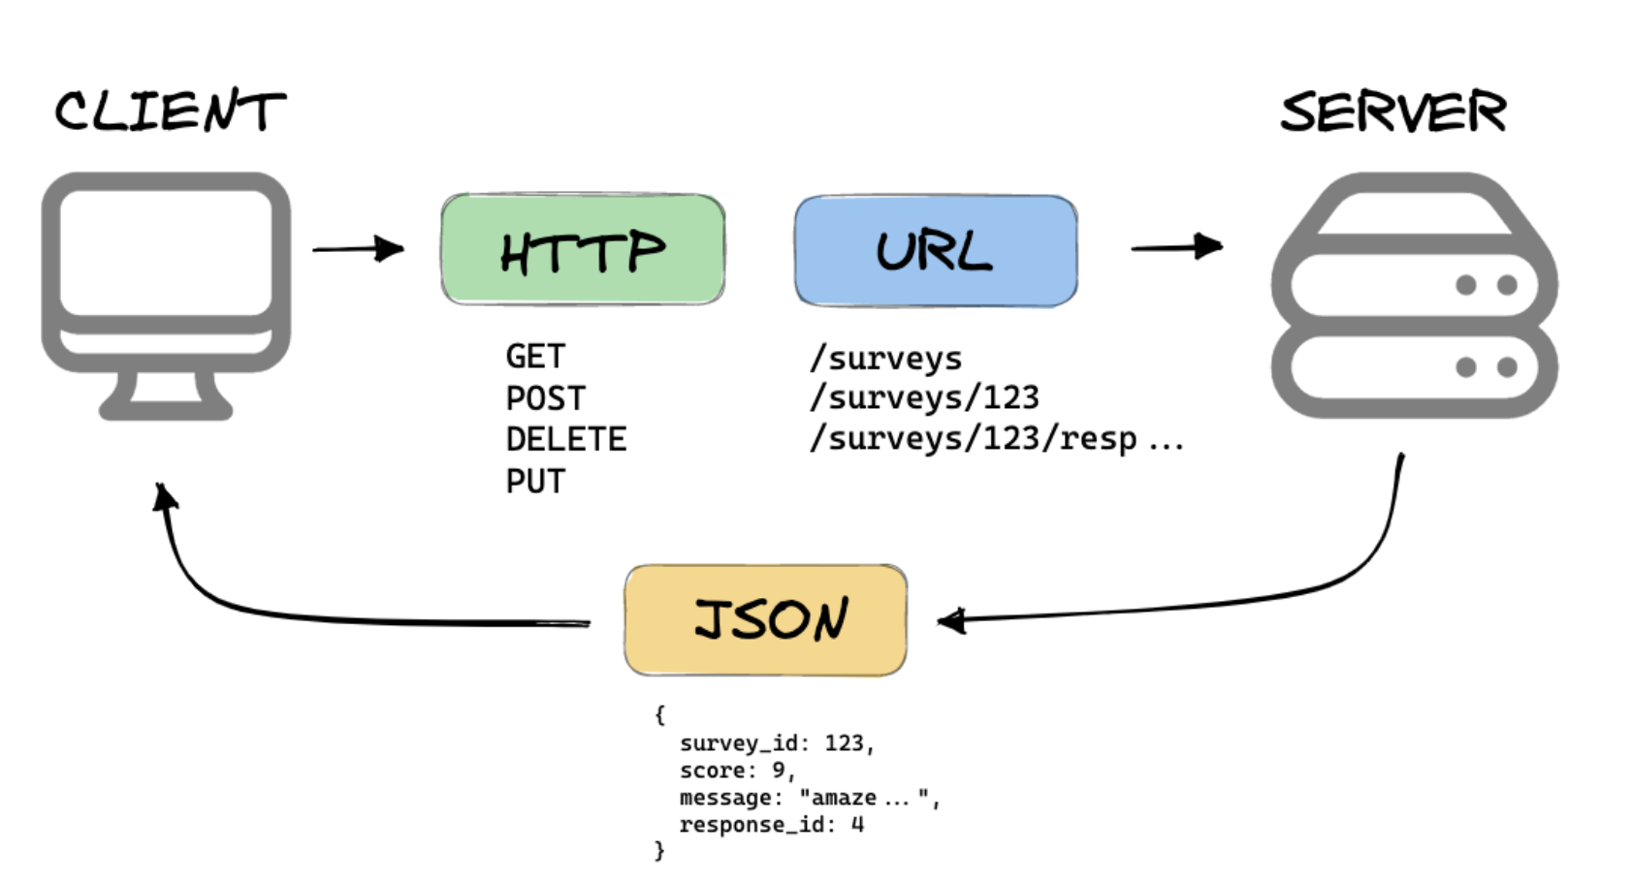
REST APIs
REST stands for Representational State Transfer
An architectural style that defines a set of standards for building Web APIs
REST APIs (RESTful APIs) are APIs that follow the the REST standards
Image from www.bytebytego.com
COM3550, Undergraduate Ambassadors Scheme
1/14

Slide 6
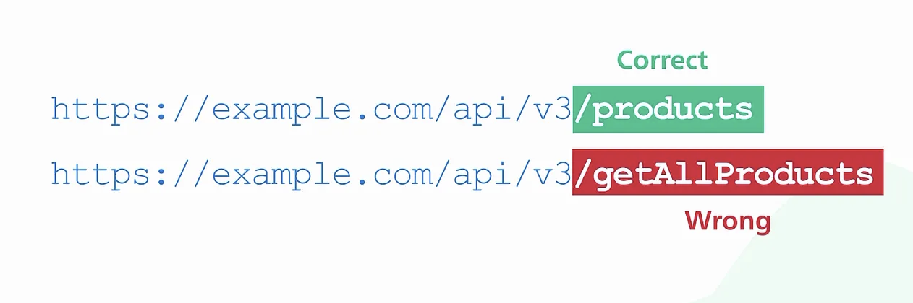
REST API Principles
(1) Uniform Interface
A RESTful API organises resources into a set of unique URIs (Uniform Resources Identifiers)
URIs identify different resources in a server e.g:
https://example.com/api/v3/products
https://example.com/api/v3/users
Resources should be grouped by noun and not verb
COM3550, Undergraduate Ambassadors Scheme
1/14

Slide 7
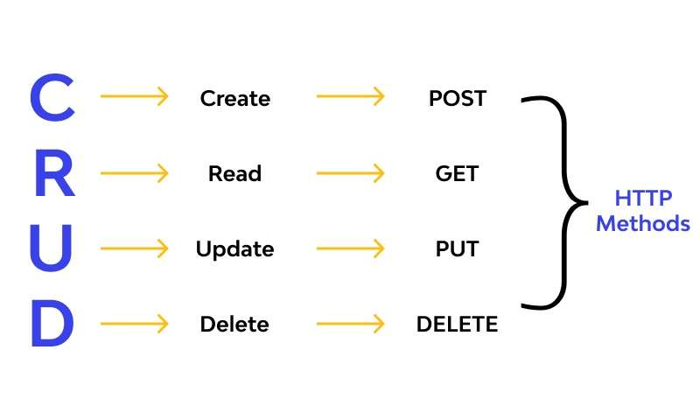
REST API Principles
Clients (e.g., your web or mobile app) interact with resources by sending a request to the endpoint of that resource using HTTP
POST Create a new resource (e.g., adding a new user).
GET Read data (e.g., fetching product details).
PUT Update an existing resource (e.g., editing user details).
DELETE Delete a resource (e.g., deleting a user account).
Server returns a response (HTML/JSON/XML) and HTTP status codes
Status codes inform clients about the result of their requests
200 OK = request succeeded
404 Not found = requested resource doesn’t exist
500 Internal Server Error = a server-side error occurred
COM3550, Undergraduate Ambassadors Scheme
1/14

Slide 8
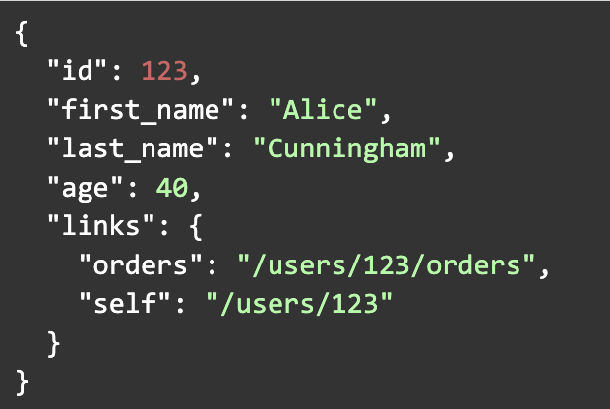
REST API Principles
Example Response:
A GET request to https://example.com/users/123 might return:
COM3550, Undergraduate Ambassadors Scheme
1/14

Slide 9
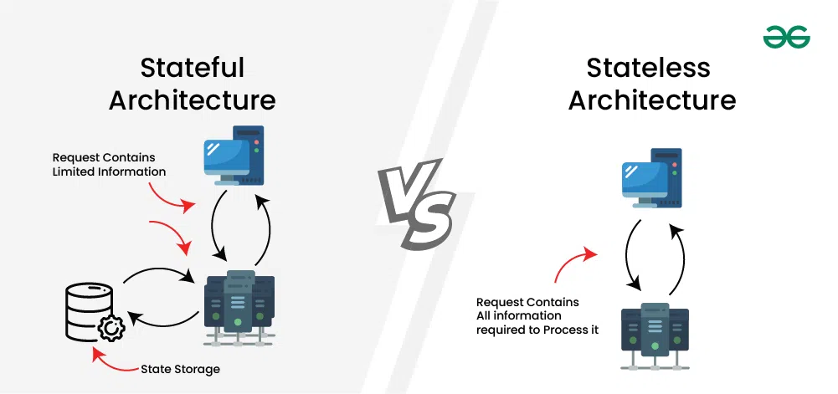
REST API Principles
(2) Client-Server Architecture
The client and server (the backend API) are separated
Client: Responsible for the user interface and user experience
Server: Handles the data storage, processing and business logic
(3) Stateless
Each request is treated independently i.e the server doesn’t maintain any session information about the previous request
Hence, requests must contain ALL the information the server needs to process it
COM3550, Undergraduate Ambassadors Scheme
1/14

Slide 10
REST API Principles
(4) Cacheability
Responses define themselves as cacheable or not to improve performance
If a response is cacheable, clients can reuse them for subsequent requests
Example: A GET request to /products might return a list of products along with cache headers (e.g., Cache-Control: max-age=3600) to instruct clients to cache the result for an hour.
(5) Layered System
A client cannot tell whether it is connected directly to the end server, or to an intermediary along the way
(6) Code on demand (optional)
Servers may send executable code to clients, allowing the client to run that code locally
Most APIs return only data (JSON/XML), so not always needed
COM3550, Undergraduate Ambassadors Scheme
1/14

Slide 11
OpenAI Developer APIs
COM3550, Undergraduate Ambassadors Scheme
1/14

Slide 12
OpenAI Developer APIs
OpenAI provides APIs that enable developers to integrate AI-powered models like GPT, DALL·E, and Whisper into applications.
Examples:
Chat Completions API - text generation / completion
Images API - image generation, edits and variations
Audio API - text-to-speech (TTS), speech-to-text (STT)
Moderations API - check for harmful contents in text/images
Embeddings API - generate vector representation of text
For this project, we will be using Chat API
Read the docs ⇒ https://platform.openai.com/docs
COM3550, Undergraduate Ambassadors Scheme
1/14

Slide 13
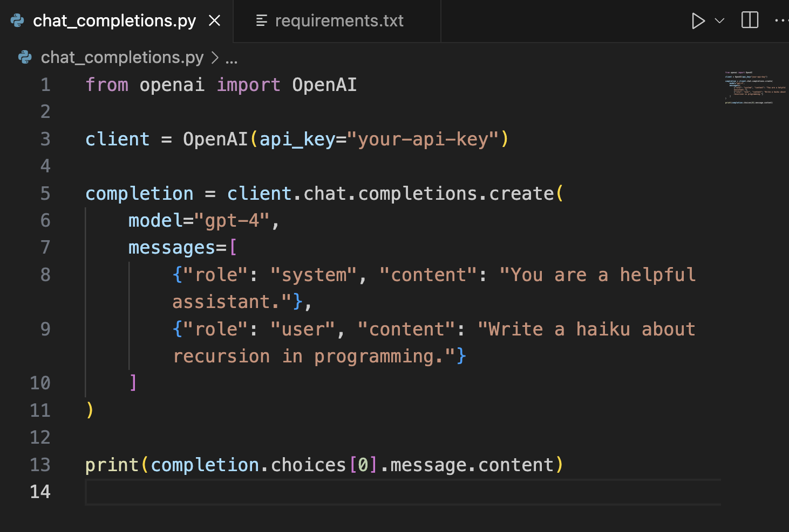
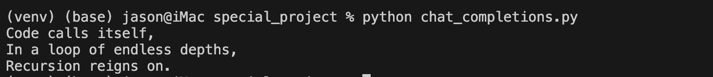
Chat Completions API
Unlike Web APIs, OpenAI APIs function as library-based APIs, which can be integrated into programs by importing the appropriate library for a given programming language.
Python Code Example:
COM3550, Undergraduate Ambassadors Scheme
1/14

Slide 14
Chat Completions API
Let's break down the most important parameters you can use when making API calls
model
Specifies which GPT model to use (e.g "gpt-4", "gpt-3.5-turbo")
Each model has different capabilities and cost tokens
messages
An array of message objects that forms basis of the conversation
Each message needs a 'role' and 'content'
Roles can be:
system (sets behavior)
user (your input)
assistant (AI's responses)
temperature
Controls randomness in responses
Ranges between 0 to 2
0 = very focused, deterministic
1 = more creative, varied
COM3550, Undergraduate Ambassadors Scheme
1/14

Slide 15
Chat Completions API
Let's break down the most important parameters you can use when making API calls
max_tokens
Limits the length of the response
Higher values = longer responses = costing more tokens
🎯 Best practices
Start with default parameters and adjust as needed
Always include a clear system message
Monitor your token usage!
Temperature control
Lower temperature (0.1-0.3) for factual/coding tasks
Higher temperature (0.7-1.0) for creative tasks
For complete list of parameters, see https://platform.openai.com/docs/api-reference/chat
COM3550, Undergraduate Ambassadors Scheme
1/14

Slide 16
Summary
COM3550, Undergraduate Ambassadors Scheme
1/14

Slide 17
Summary
APIs allow different software applications to communicate.
REST APIs are APIs that follow the REST principles
(uniform interface, client-server, stateless, cacheable, layered system)
OpenAI APIs enable seamless integration of AI models into applications.
Chat Completions API can be used with different models to generate human-like text and code.
Each model cost different amount of tokens!
COM3550, Undergraduate Ambassadors Scheme
1/14

Slide 18
Questions?
COM3550, Undergraduate Ambassadors Scheme 1/x

